Slide 1




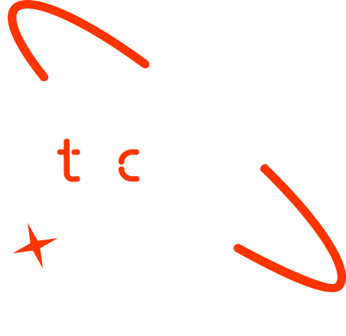

Forecasting Future Energy Consumption for Households and Businesses
OUEDRAOGO Yann Boris
OUEDRAOGO Ousmane
KALMOGO Lucien
Edy SCOFY
17/01/2025

Slide 2

Outline
Concept note and implementation plan
Background
Objectives
SDG Relation
Data
Data Collection
Exploratory Data Analysis et Feature Engineering
Model
Model Selection and Training
Model Evaluation and Hyperparameter Tuning
Model Refinement and Testing
Results
Evaluation Results
Deployment
Future Work

Slide 3
Concept note and Implementation Plan
Notes:
FTs like precision agriculture, remote sensing & AI-powered forming equipment can help increase agricultural productivity in LDCs. This can improve fiid security & contribute to the achievement of SDG 2 (Zero Hunger).

Slide 4
Background
The project focuses on creating an AI model to forecast energy consumption for households and businesses.
This solution will help optimize energy usage, reduce wastage, and support sustainable energy systems.
Notes:
FTs like precision agriculture, remote sensing & AI-powered forming equipment can help increase agricultural productivity in LDCs. This can improve fiid security & contribute to the achievement of SDG 2 (Zero Hunger).

Slide 5
Objectives
- Forecast energy consumption.
- Balance supply and demand.
- Promote sustainability.
Notes:
FTs like precision agriculture, remote sensing & AI-powered forming equipment can help increase agricultural productivity in LDCs. This can improve fiid security & contribute to the achievement of SDG 2 (Zero Hunger).

Slide 6

SDG Relation
- SDG 7: Affordable and Clean Energy
- SDG 13: Climate Action
Add your SDG image here
Notes:
Here is the infographic visualizing the connection between the energy forecasting project and the United Nations Sustainable Development Goals (SDGs), specifically highlighting SDG 7 (Affordable and Clean Energy) and SDG 13 (Climate Action).

Slide 7
Data
Notes:
FTs like precision agriculture, remote sensing & AI-powered forming equipment can help increase agricultural productivity in LDCs. This can improve fiid security & contribute to the achievement of SDG 2 (Zero Hunger).

Slide 8
Data Collection
- Public datasets (Open Power System Data).
Notes:
FTs like precision agriculture, remote sensing & AI-powered forming equipment can help increase agricultural productivity in LDCs. This can improve fiid security & contribute to the achievement of SDG 2 (Zero Hunger).

Slide 9
Exploratory Data Analysis and Feature Engineering
- Missing value handling.
- Feature engineering.
- Data normalization (MinMaxScaler).
Notes:
FTs like precision agriculture, remote sensing & AI-powered forming equipment can help increase agricultural productivity in LDCs. This can improve fiid security & contribute to the achievement of SDG 2 (Zero Hunger).

Slide 10
Model
Notes:
FTs like precision agriculture, remote sensing & AI-powered forming equipment can help increase agricultural productivity in LDCs. This can improve fiid security & contribute to the achievement of SDG 2 (Zero Hunger).

Slide 11
Model Selection and Training
Models Evaluated:
- ARIMA, XGBoost, and LSTM.
Selected Model:
- LSTM due to superior performance (MAE: 95.3).
Notes:
FTs like precision agriculture, remote sensing & AI-powered forming equipment can help increase agricultural productivity in LDCs. This can improve fiid security & contribute to the achievement of SDG 2 (Zero Hunger).

Slide 12
Model Evaluation and Hyperparameter Tuning
Evaluation Metrics:
- Mean Absolute Error (MAE).
Hyperparameter Tuning:
- Grid Search CV for optimal parameters.
Notes:
FTs like precision agriculture, remote sensing & AI-powered forming equipment can help increase agricultural productivity in LDCs. This can improve fiid security & contribute to the achievement of SDG 2 (Zero Hunger).

Slide 13
Model Refinement and Testing
Refinement Techniques:
- Fine-tuning layers, learning rates, and activation functions.
- Cross-validation and data scaling.
Notes:
FTs like precision agriculture, remote sensing & AI-powered forming equipment can help increase agricultural productivity in LDCs. This can improve fiid security & contribute to the achievement of SDG 2 (Zero Hunger).

Slide 14
Results
Notes:
FTs like precision agriculture, remote sensing & AI-powered forming equipment can help increase agricultural productivity in LDCs. This can improve fiid security & contribute to the achievement of SDG 2 (Zero Hunger).

Slide 15
Evaluation Results
LSTM Model Results:
- Train MAE: 95.65
- Test MAE: 93.35
Model robustness confirmed via visual analysis.
Notes:
FTs like precision agriculture, remote sensing & AI-powered forming equipment can help increase agricultural productivity in LDCs. This can improve fiid security & contribute to the achievement of SDG 2 (Zero Hunger).

Slide 16
Deployment
Deployment Method:
- Django REST API with React frontend.
Features:
- Real-time predictions.
Notes:
FTs like precision agriculture, remote sensing & AI-powered forming equipment can help increase agricultural productivity in LDCs. This can improve fiid security & contribute to the achievement of SDG 2 (Zero Hunger).

Slide 17
Future Work
- Integrate real-time weather data.
- Improve model scalability.
- Implement API security.
Notes:
FTs like precision agriculture, remote sensing & AI-powered forming equipment can help increase agricultural productivity in LDCs. This can improve fiid security & contribute to the achievement of SDG 2 (Zero Hunger).

Slide 18
References
- Maria Jacob, Forecasting Household Energy Consumption.
- Arpad Gellert et al., Forecasting Electricity Consumption in Smart Homes.
- https://medium.com/latinxinai/evaluation-metrics-for-regression-models-03f2143ecec2
Notes:
FTs like precision agriculture, remote sensing & AI-powered forming equipment can help increase agricultural productivity in LDCs. This can improve fiid security & contribute to the achievement of SDG 2 (Zero Hunger).

Slide 19

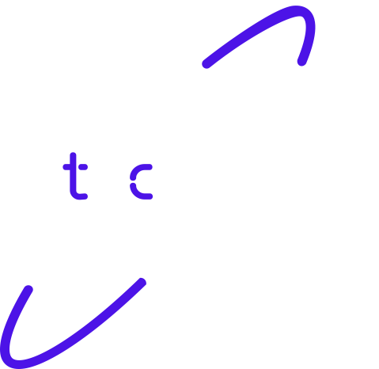
Thank you!

